Slide 1
19AIE303
Signal & Image Processing
END SEMESTER PROJECT

Slide 2
Saliency Detection using Dynamic Mode Decomposition and its variants
BY
TEAM - 5

Slide 3
TEAM MEMBERS
CB.EN.U4AIE20004 AMEEN ASHADULLAH M
CB.EN.U4AIE20017 GHAAYATHRI DEVI K
CB.EN.U4AIE20019 GORANTLA V N S L Vishnu Vardhan
CB.EN.U4AIE20039 Menta Sai Aashish
CB.EN.U4AIE20062 Sai Aravind V

Slide 4
OBJECTIVE
DMD and its Variants
Utilise DMD and its variants to generate saliency map
Analyze color spaces
- to improve image representation by separating luminance and chrominance and generating the saliency map.
Analysis (Visual + Quantitative)
Visually and quantitatively analyse the effectiveness of each of these variants

Slide 5
Literature Review
Salient region detection methods
Global contrast based methods
Local contrast based methods

Slide 6
Timeline on important developments in this field
Cheng et al. in 2014, in which they proposed a DMD-based saliency detection method that can effectively extract the most salient regions in an image.
In 2015, Yang et al. proposed a DMD-based saliency detection method that can handle both static and dynamic images
In 2018, Li et al. proposed a DMD-based saliency detection method that can handle images with complex backgrounds.
In 2019, Zhang et al. proposed a DMD-based saliency detection method that can handle images with small objects.
Overall, DMD-based saliency detection methods have been shown to be effective in extracting the most salient regions in an image. However, these methods have some limitations, such as the need for a large number of images and the high computational cost. Despite these limitations, DMD-based saliency detection methods have the potential to improve the performance of saliency detection, and further research in this area is expected to yield promising results.

Slide 7
Where Saliency Detection is applied in previous literature
Object Recognition
Scene Understanding
Attention Modeling
Visual Search
Saliency detection can be used to identify the most salient objects in an image and to guide the object recognition process by focusing attention on the most relevant regions of an image.
This can improve the performance of object recognition algorithms, especially when the objects of interest are small or partially occluded.
Saliency detection can be used to identify the most salient regions of an image and to guide the scene understanding process by focusing attention on the most informative regions of an image. This can improve the performance of scene understanding algorithms, especially when the scene contains multiple objects or complex backgrounds.
Saliency detection can be used to model human attention and to predict the regions of an image that are most likely to be attended to by humans. This can be used to improve the performance of systems, such as image retrieval and image annotation systems, by guiding the system's attention to the most relevant regions of an image.
Saliency detection can be used to guide the visual search process by focusing attention on the most salient regions of an image. This can improve the performance of visual search algorithms, especially when the search target is small or partially occluded.

Slide 8
Conventional methods used
By combining simple priors
Non-parametric Regression Saliency
Regional Covariance Matrices

Slide 9
Combining Simple Priors
Advantages:
Low computational complexity
Useful for time critical applications
Frequency Prior
Simple Prior
Color Prior
Limitation:
Fails when the dataset is complex
Location Prior

Slide 10
Non-parametric Regression Saliency
Compute dissimilarities between a center patch of a region & other patches
Aggregate them to estimate underlying saliency of the region
Image
Gaussian white noise
By local data dependant weighted least square problem
Fails when the image is foggy or has low resolution, snowy or rainy

Slide 11
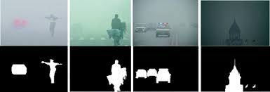
Regional Covariance Matrices
USAGE:
Used for the images of type:
Foggy
Rainy
Snowy
Cloudy
Smoky
Limitation:
Affect saliency detection based on color domain
Solution:
Use global edge detection method
Future scope:
Extracting sensitive fog image features and reduce errors

Slide 12
WHAT IS THE NEED FOR DMD ?
Conventional methods:
Extracts either spatial coherent structure or temporal structure of the image
DMD:
Extracts both spatial coherent structure or temporal structure of the image

Slide 13
Variants of Dynamic Mode Decomposition
Standard DMD
rSVD-DMD

Slide 14









Standard DMD
STANDARD DMD
Snapshot Sequence,
In closed form the linear operator,
where,
The dominant eigenvectors of

Slide 15
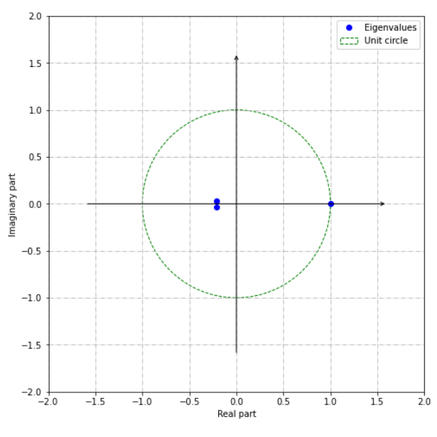
Eigenvalue spectrum of DMD

Slide 16
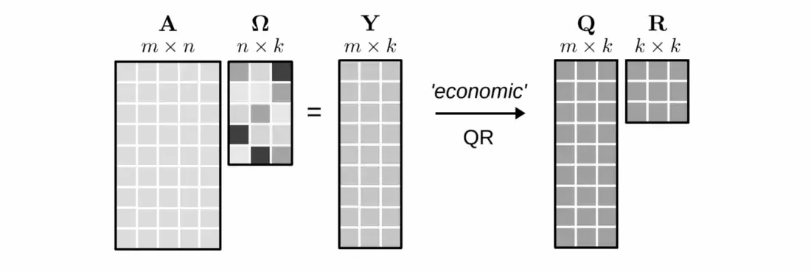
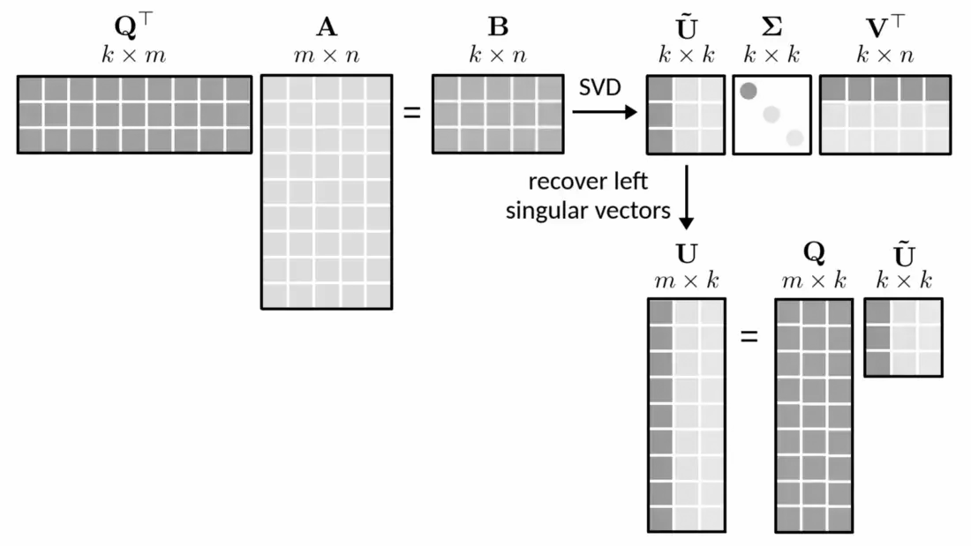
Randomized
SVD
Why do we need to randomize ?
To obtain faster and more efficient low rank approximations

Slide 17






Randomized SVD - DMD
1) Compute SVD of matrix
3)
2) Compute Best fit linear map A,
4) Compute Eigendecomposition of
5) Finally we reconstruct the k dominant eigenvectors of
Where ϕ is the dynamic mode matrix with corresponding DMD Modes.

Slide 18
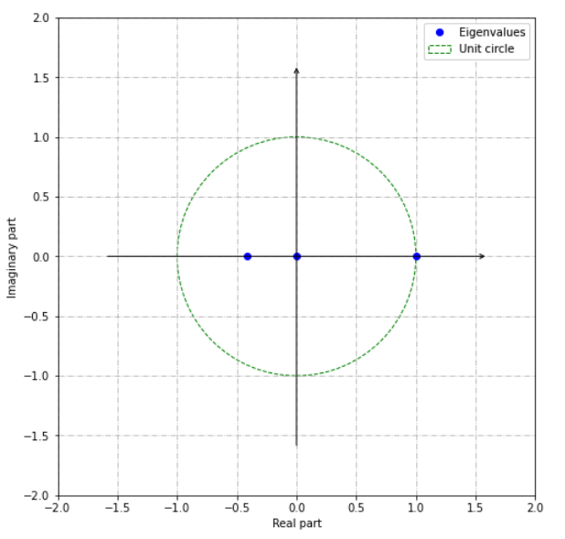
Eigenvalue spectrum of rSVD-DMD

Slide 19
Static Image Interpretation via DMD
RGB Image
The power of different color space representations is used to model the nonlinear and highly complex behavior of the human visual system, as each color space provides different color similarity measures.
CIE L*a*b Image
YUV Image
YCbCr Image

Slide 20
Color based DMD representation of images
Color is a crucial cue that attracts human attention. It is important to give a DMD representation to model the chromatic information.

Slide 21
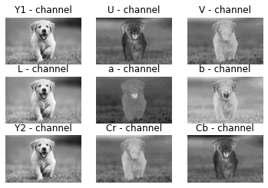
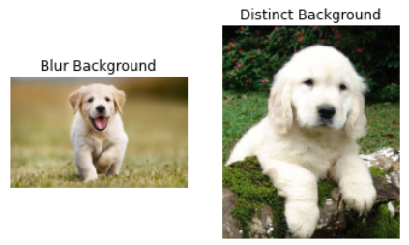
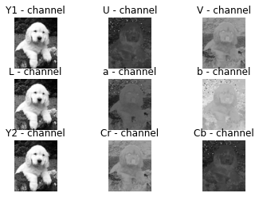
Color space analysis
Blur Background Image
Distinct Background Image
a from CIELab
U from YUV
Cb from YCbCr
b from CIELab
V from YUV
Cr from YCbCr

Slide 22
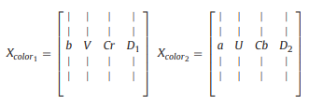
Computing the data matrix
[ From the result of color space study]
Here, D₁ = b + V + Cr and D₂ = a + U + Cb. The column vectors D₁ and D₂ represent the prominent salient regions.

Slide 23
Permutation of column vectors
[X_{color_1}]_{mnx4} and [X_{color_2}]_{mnx4} where mn is the size of the image
(m - number of rows; n - number of columns)
Input data matrix for DMD
Permutations | 1 | 2 | 3 | 4 | 5
X₁ | bVCrD₁ | VCrbD₁ | D₁CrVb | VCrD₁b | VbD₁Cr
X₂ | aUCbD₂ | UCbaD₂ | D₂CbUa | UCbD₂a | UaD₂Cb
More columns in the data matrix, the more accurately we can separate the salient part.

Slide 24
Luminance based DMD representation of images
For the images with identical background and foreground color distributions, luminance information is utilized.
Luminance Components
SVD
Reconstructed Luminance Components
DMD
Intermediate singular values: Salient part Smaller and larger singular values: Non salient part

Slide 25

Why do we need to reconstruct image using SVD ?
SVD-reconstructed images have more salient features.
Also, as the number of singular values used for reconstruction increases, the salient region becomes more clear while the background remains relatively static after a set of iterations.
Number of singular values: (1, 6, 11, 16, 21)

Slide 26
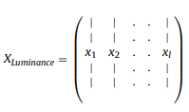
Computing the data matrix
Vectorize each of the SVD images and unite them into a single data matrix.
When there are l intermediate singular values, the mnx1 vectors x₁, x₂, x₃,..x_{l} where each x_{i} represents a vectorized mxn SVD reconstructed image.

Slide 27
Salient Region Detection using DMD
Color saliency map
Full saliency map
Segmentation of images
Luminance saliency map

Slide 28
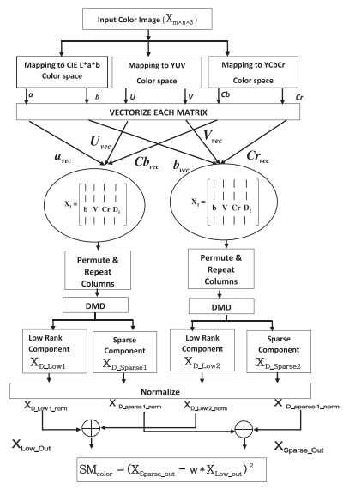
Color based saliency map
Normalization of the matrix:
X_{D_sparse1_norm} = a / b
where:
a = ( X_{D_sparse1} - min(X_{D_sparse1}))
b = (max(X_{D_sparse1}) - min(X_{D_sparse1}))

Slide 29
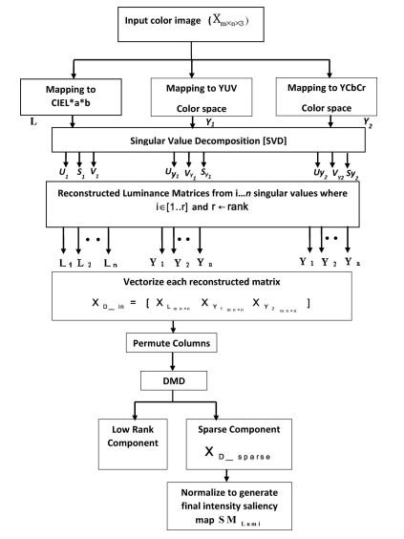
Luminance based saliency map

Slide 30
Performing SVD to data matrix
U - eigenvectors of the product of the luminance data matrix and its transpose (L*L^{T}, Y₁*Y₁^{T}, Y₂*Y₂^{T})
V- eigenvectors of the product of the transpose of the luminance data and the luminance matrix (L^{T}*L,Y₁^{T}*Y₁,Y₂^{T}*Y₂)
SVD
S - square root of the eigenvalues of (L*L^{T}, Y₁*Y₁^{T}, Y₂*Y₂^{T}) and (L^{T}*L,Y₁^{T}*Y₁,Y₂^{T}*Y₂) as diagonal elements in descending order.

Slide 31
Color and luminance saliency map enhancement
Color based
saliency map
Luminance based
saliency map
Morphological Dilation
Morphological Erosion
The final saliency map can be further enhanced by giving more weight to the salient region and suppressing the non-salient pixels.
Color based
Prior saliency map
Luminance based prior
saliency map

Slide 32
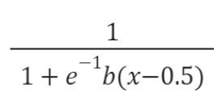
kernel δ
δ = α*sqrt(SM_{prior}) where α is a constant set as 5.
Erosion
Source Image
Color enhanced saliency map
b is a constant set as 12.
max
Structuring element for reconstruction
Sigmoid function
Luminance enhanced
saliency map
Final saliency map

Slide 33
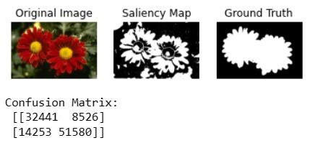
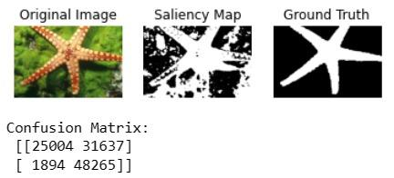
Saliency map generated using DMD Function

Slide 34
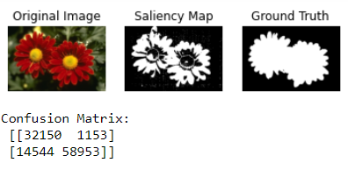
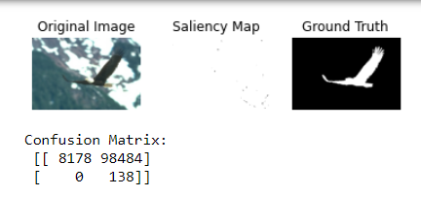
Saliency map generated using RSVD-DMD Function

Slide 35
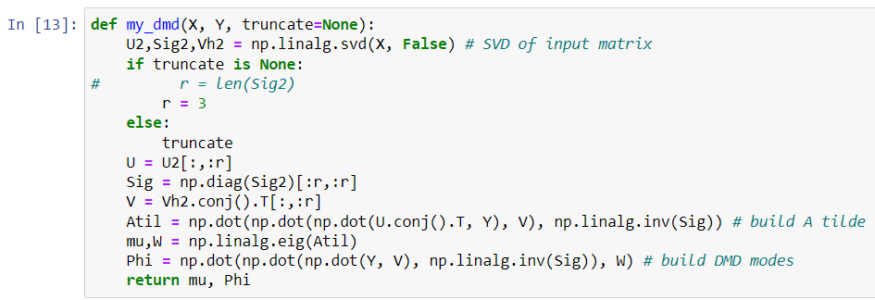
DMD FUNCTION

Slide 36
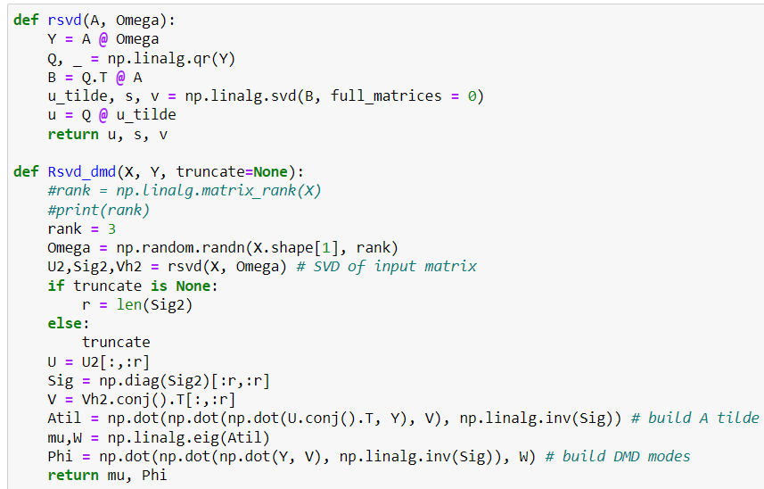
RSVD-DMD

Slide 37
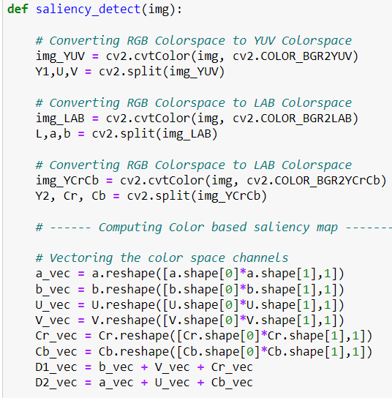
SALIENCY DETECTION

Slide 38
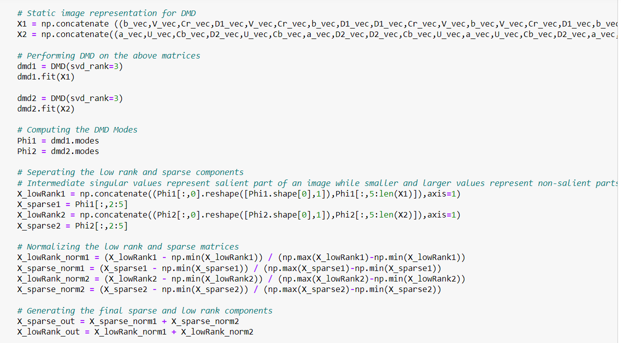

Slide 39
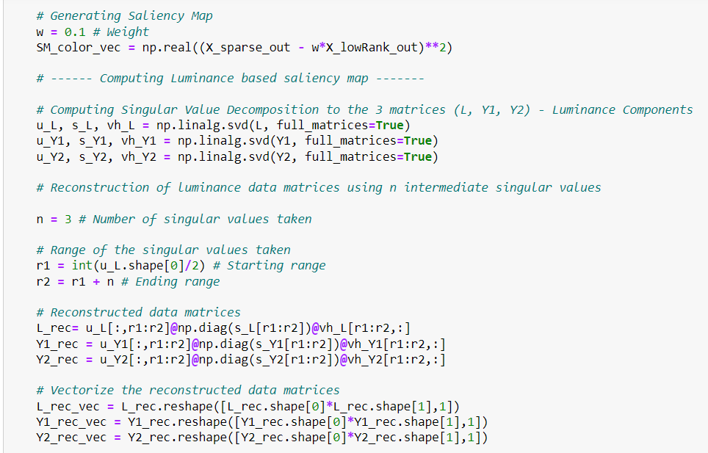

Slide 40
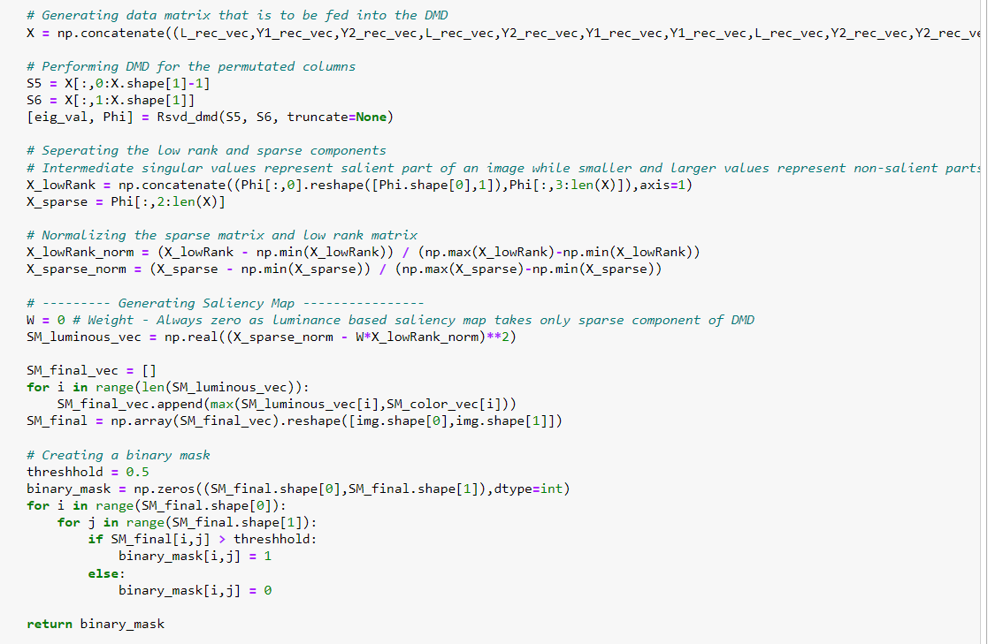

Slide 41
Experimental results and analysis

Slide 42
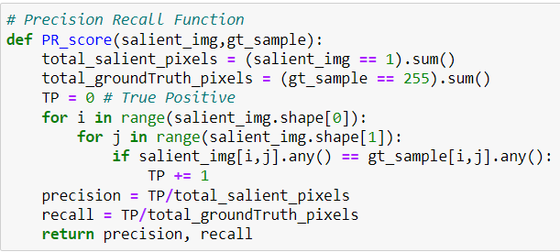
PRECISION

Slide 43
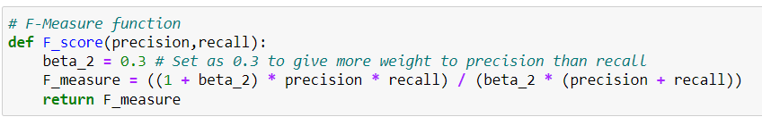
F-MEASURE

Slide 44
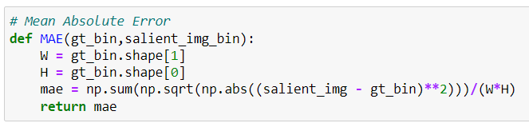
Mean Absolute Error

Slide 45
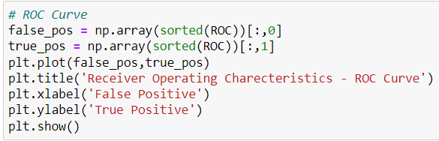
Area under ROC Curve

Slide 46
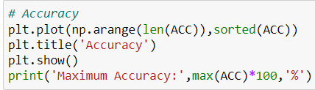
Accuracy

Slide 47
Datasets
ECSSD -
Extended Complex Scene Saliency Dataset
Consists of 1000 images
These images have textures and structures common to real world images. Several examples with their masks are provided.
We used 100 random images from this dataset for quantitative comparison.

Slide 48
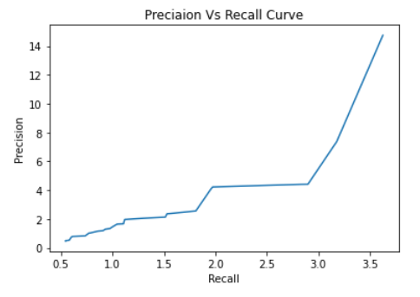
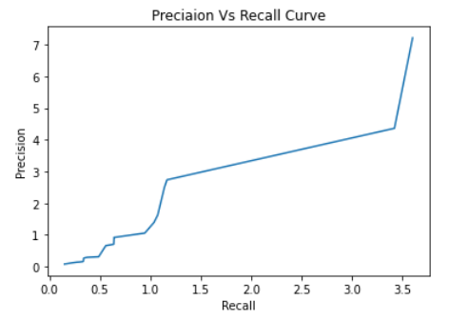
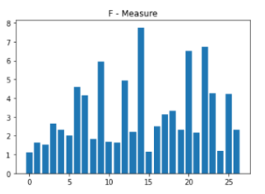
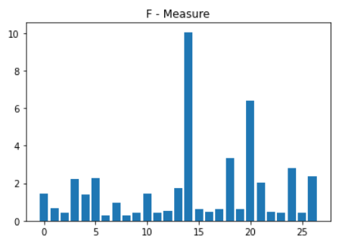
Performance evaluation: Quantitative measure: Variants of DMD
Precision-recall curve
Standard DMD:
rSVD DMD:
2. F-Measure Rate
Standard DMD:
rSVD DMD:
Precision-recall curve
F-measure rate
Mean absolute error
Area under ROC curve.

Slide 49
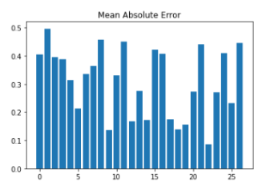
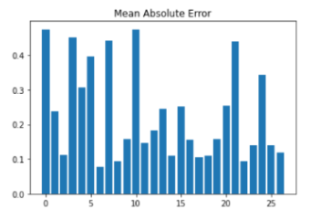
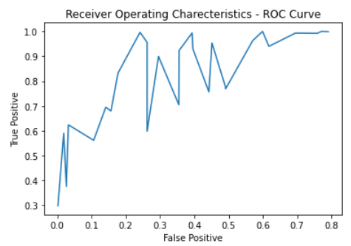
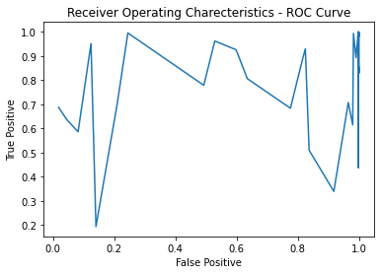
3. Mean Absolute Error
4. Area under ROC Curve
Standard DMD:
rSVD DMD:
Standard DMD:
rSVD DMD:
AUC Measure:
0.873156726805586
AUC Measure:
0.8915238046099319

Slide 50
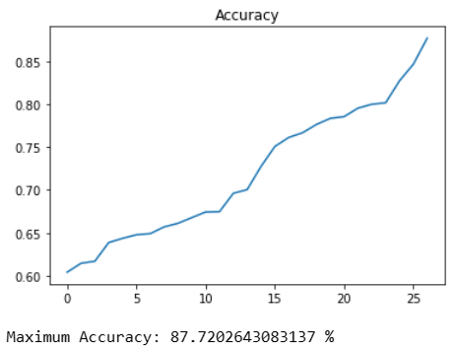
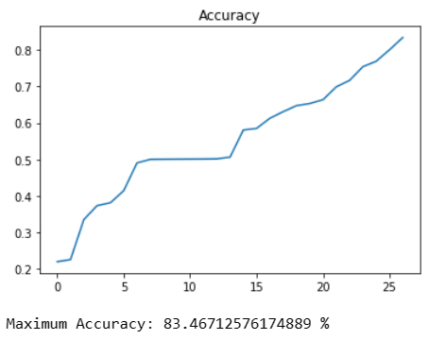
5. Accuracy
Standard DMD:
rSVD DMD:

Slide 51
Failure cases
The dynamic mode decomposition method
captures the difference between consecutive columns in the data matrix
modes bounded away from the origin are detected as the salient region.
In scenarios where the background and foreground distributions in the image are highly overlapping and the background is highly textured, the color and intensity based image representations become undesirable for the application of DMD.
When the images have a highly structured background with the same color distributions as the foreground.

Slide 52
Future Works
Future research in saliency detection should focus on developing more robust and general methods that can handle the high variability of natural scenes.
This could include the development of more sophisticated models that can take into account multiple levels of visual information, such as feature, object and scene level information, as well as the integration of other modalities such as audio and haptic information.
Additionally, research on the combination of saliency detection with other computer vision tasks, such as object detection, segmentation and tracking, is an area of active research and is expected to yield promising results
We intent to work on TDMD and Noisy Image Dataset which are currently unavailable.

Slide 53
Conclusion
DMD based model achieves competitive performance and is computationally efficient compared to other traditional saliency detection methods.
can be used efficiently for image classification, object detection and image retrieval applications.
Computationally liable and noisy dependent.
Standard DMD offers satisfactory performance.
The worst performance is obtained for rSVD-DMD because it is affected by the fluctuations and uncertainties in the measured data.

Slide 54
Thank you

